Slide 1
Avinu Malkeinu page 384 in the Rosh Hashanah Artscroll page 111 in the Rosh Hashanah Routledge

Slide 2
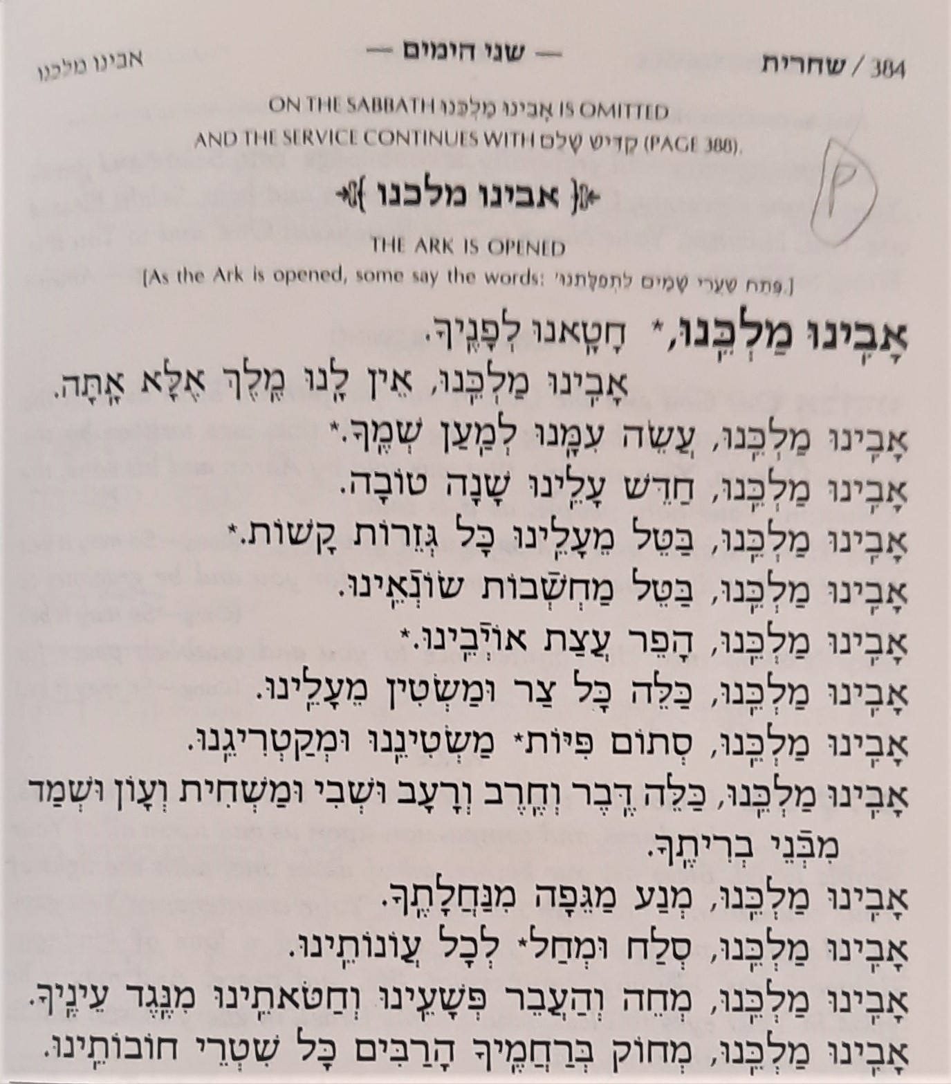
Start

Slide 3
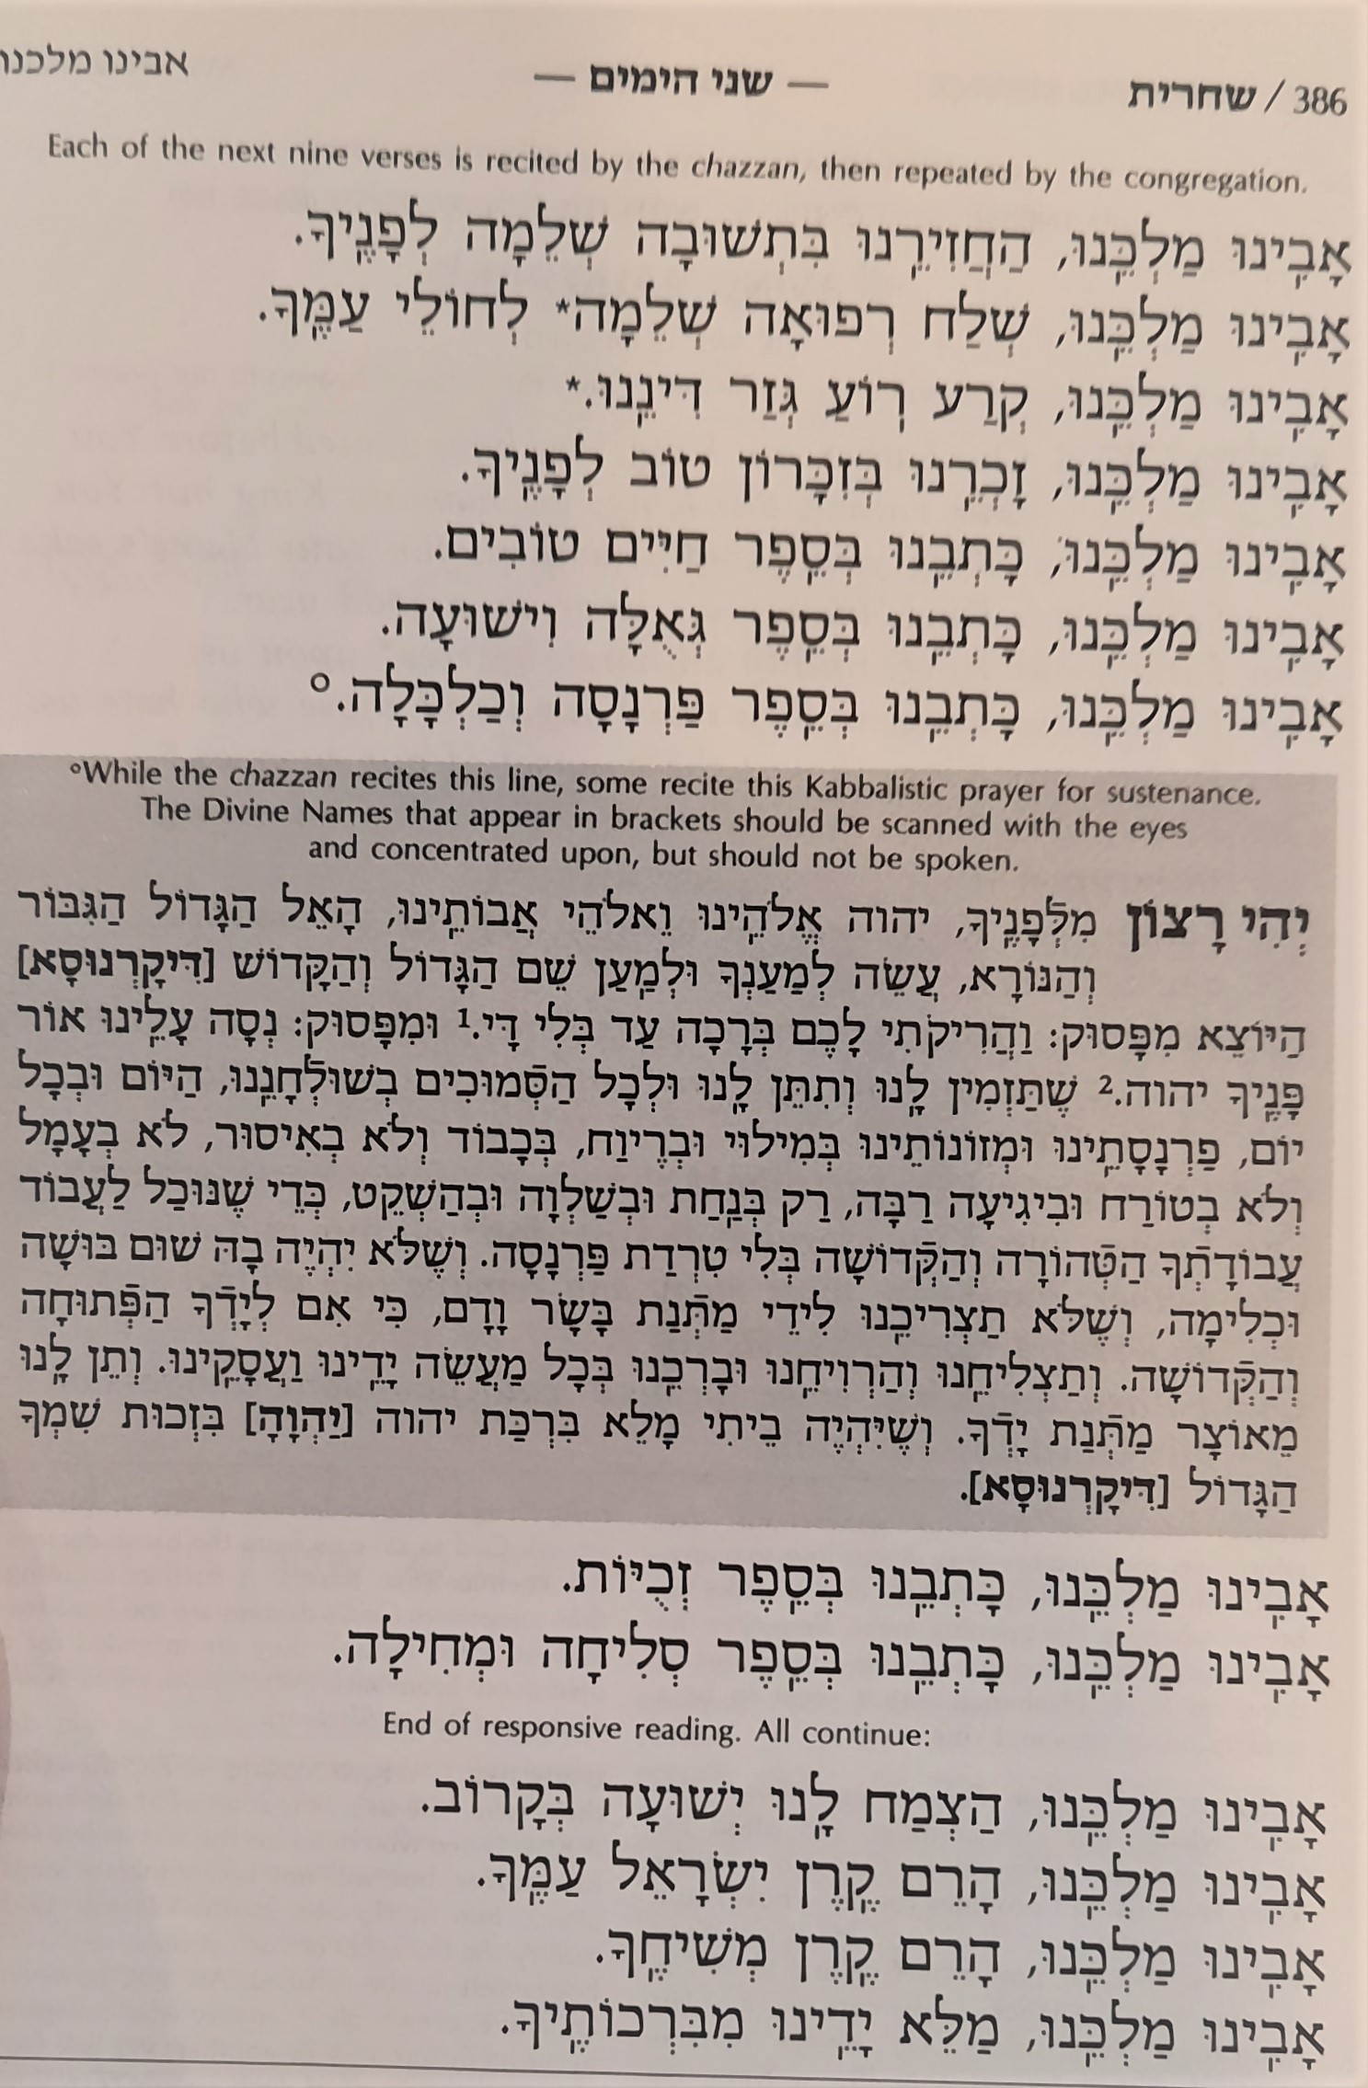

Slide 4
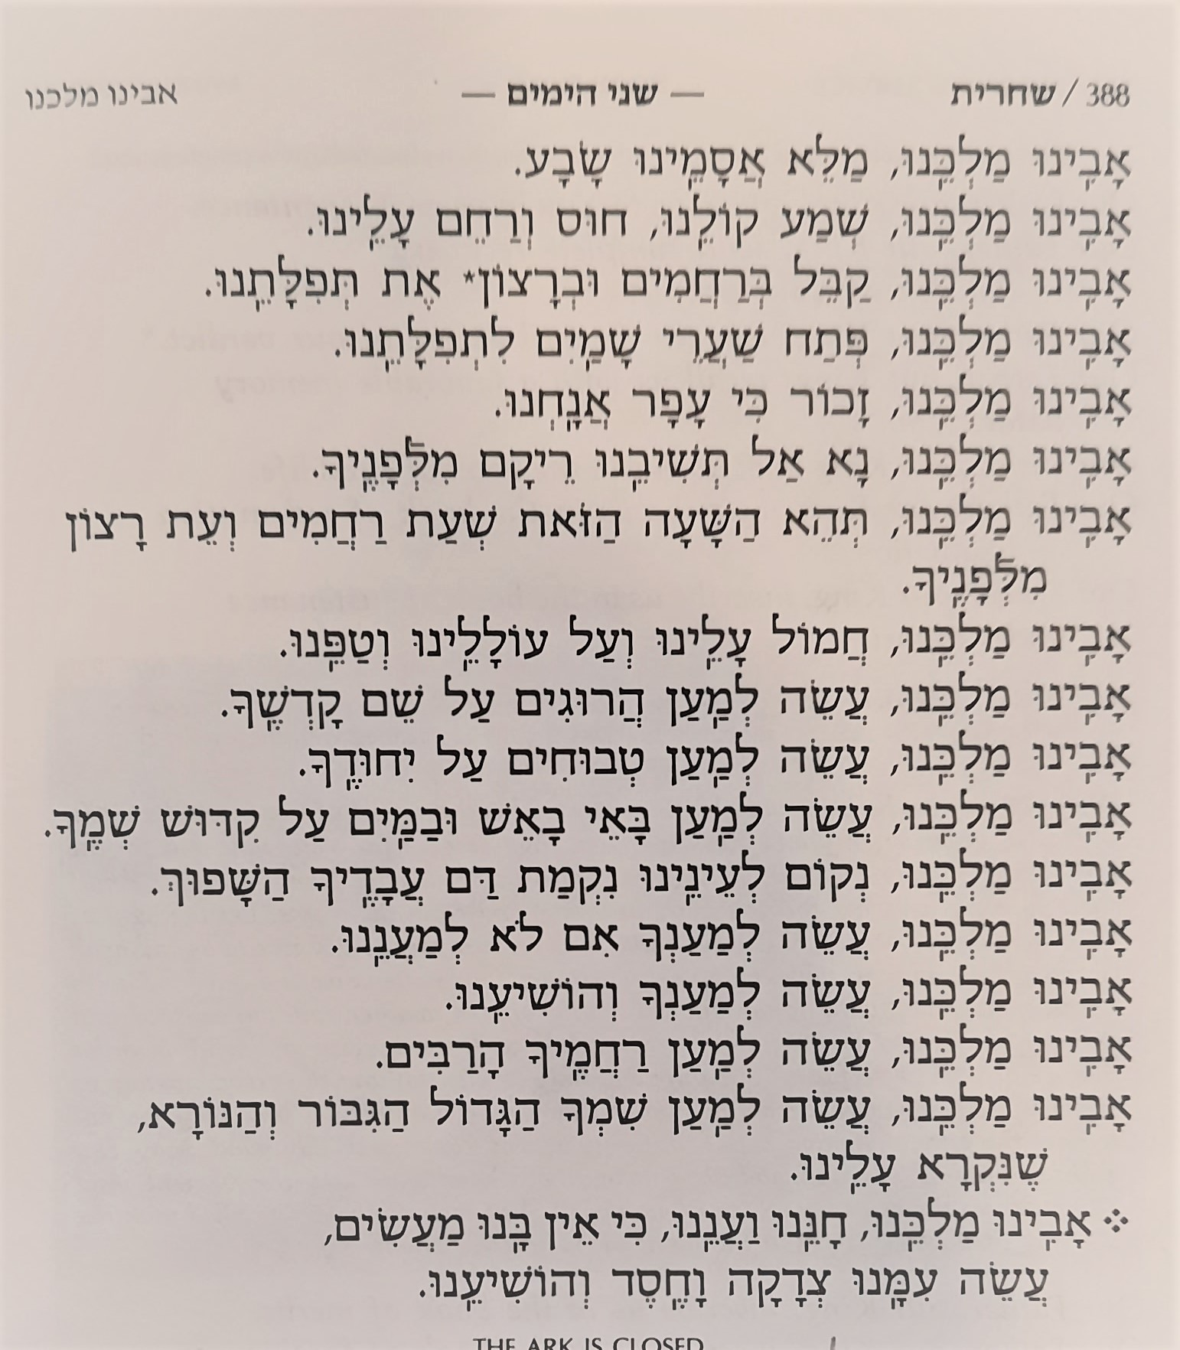
End

Slide 5
Hayom Harat Olam & Areshet Sefateinu page 508-510 in the Rosh Hashanah Artscroll page 157 in the Rosh Hashanah Routledge

Slide 6
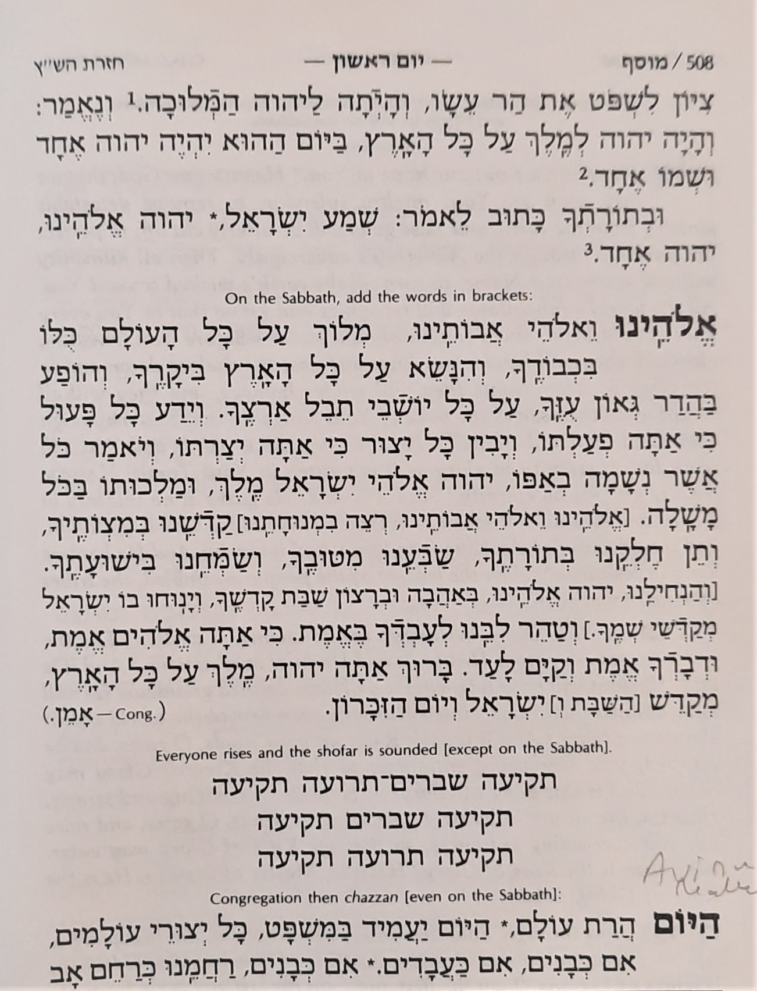
Start

Slide 7
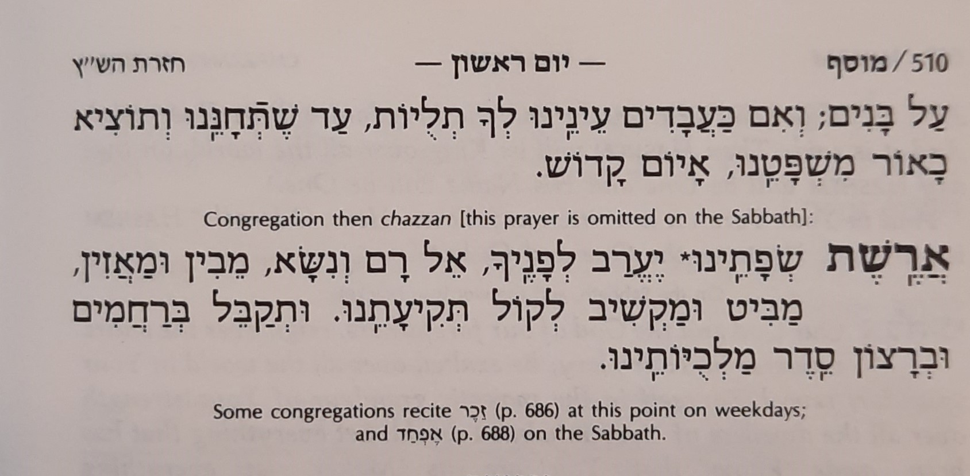
End

Slide 8
Rosh Hashanah
Blessings on Candles page 18 in the Rosh Hashanah Artscroll page 8 in the Rosh Hashanah Routledge

Slide 9
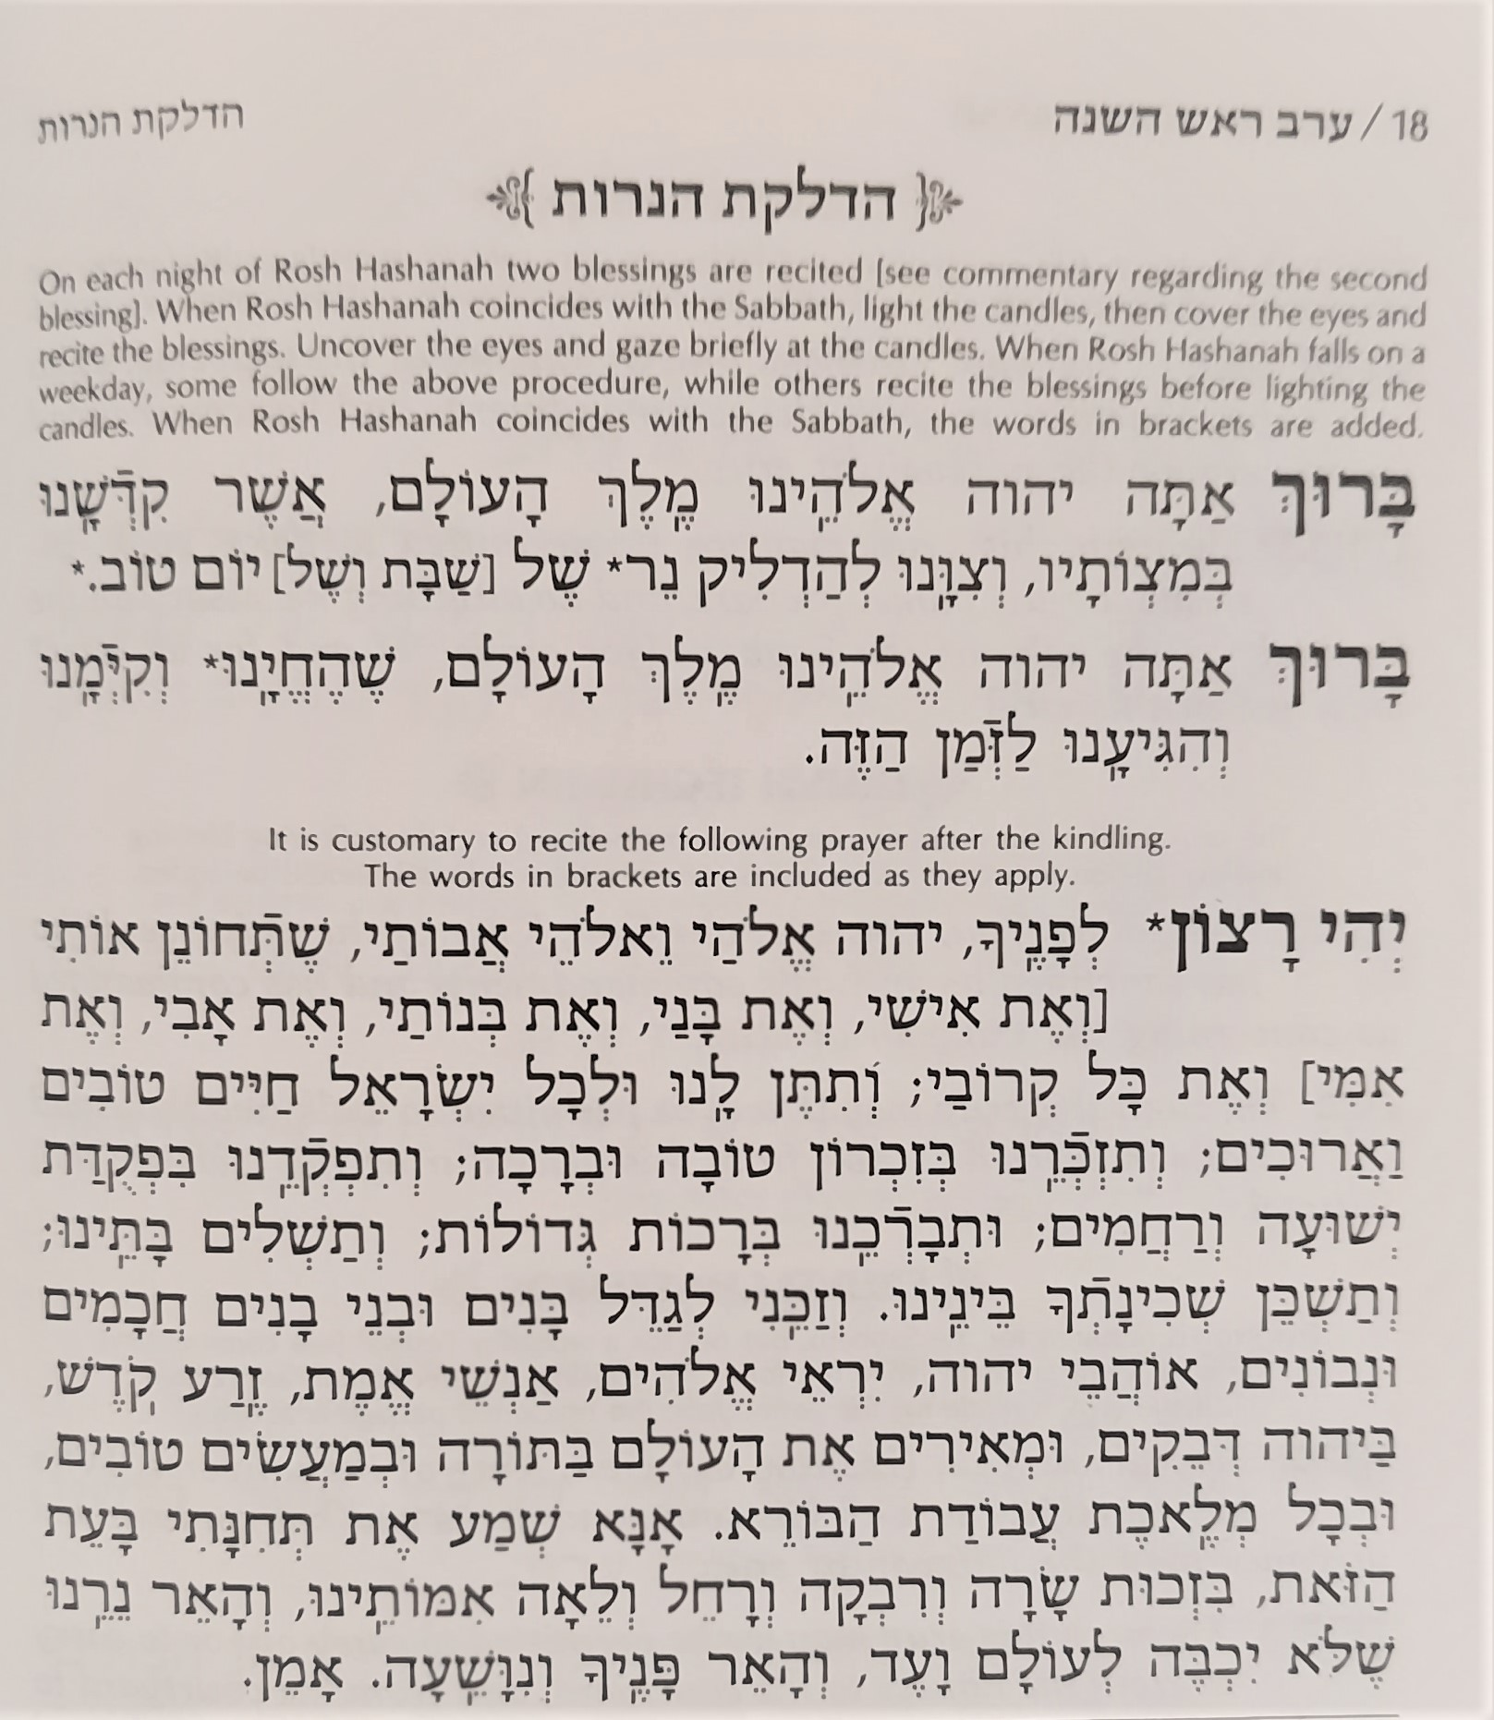
Start
End

Slide 10
Yom Kippur
Blessings on Candles page 34 in the Yom Kippur Artscroll

Slide 11
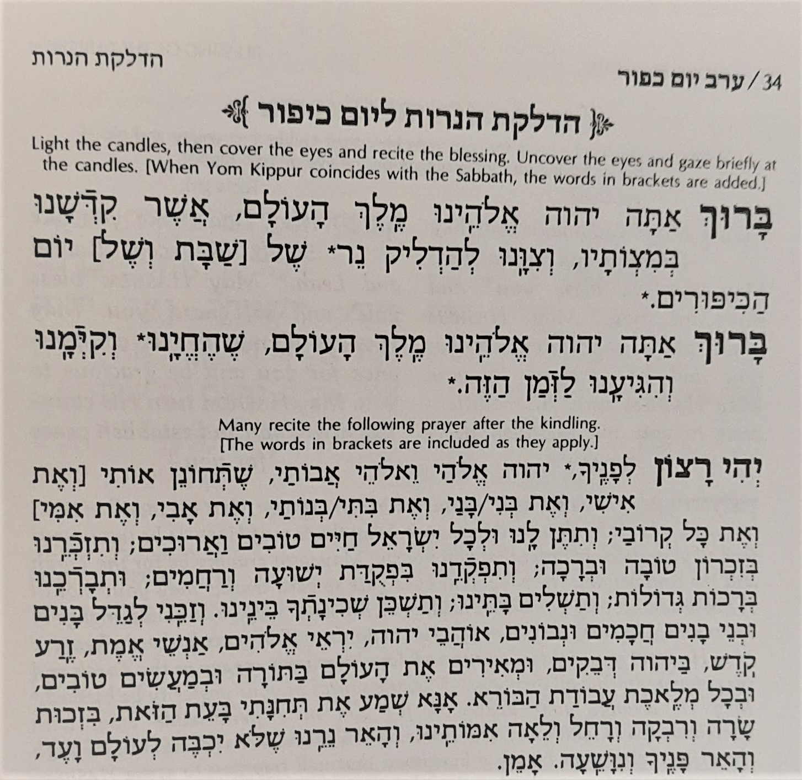
Start
End

Slide 12
Unetaneh Tokef page 480-2 in the Rosh Hashanah Artscroll page 146-7 in the Rosh Hashanah Routledge

Slide 13
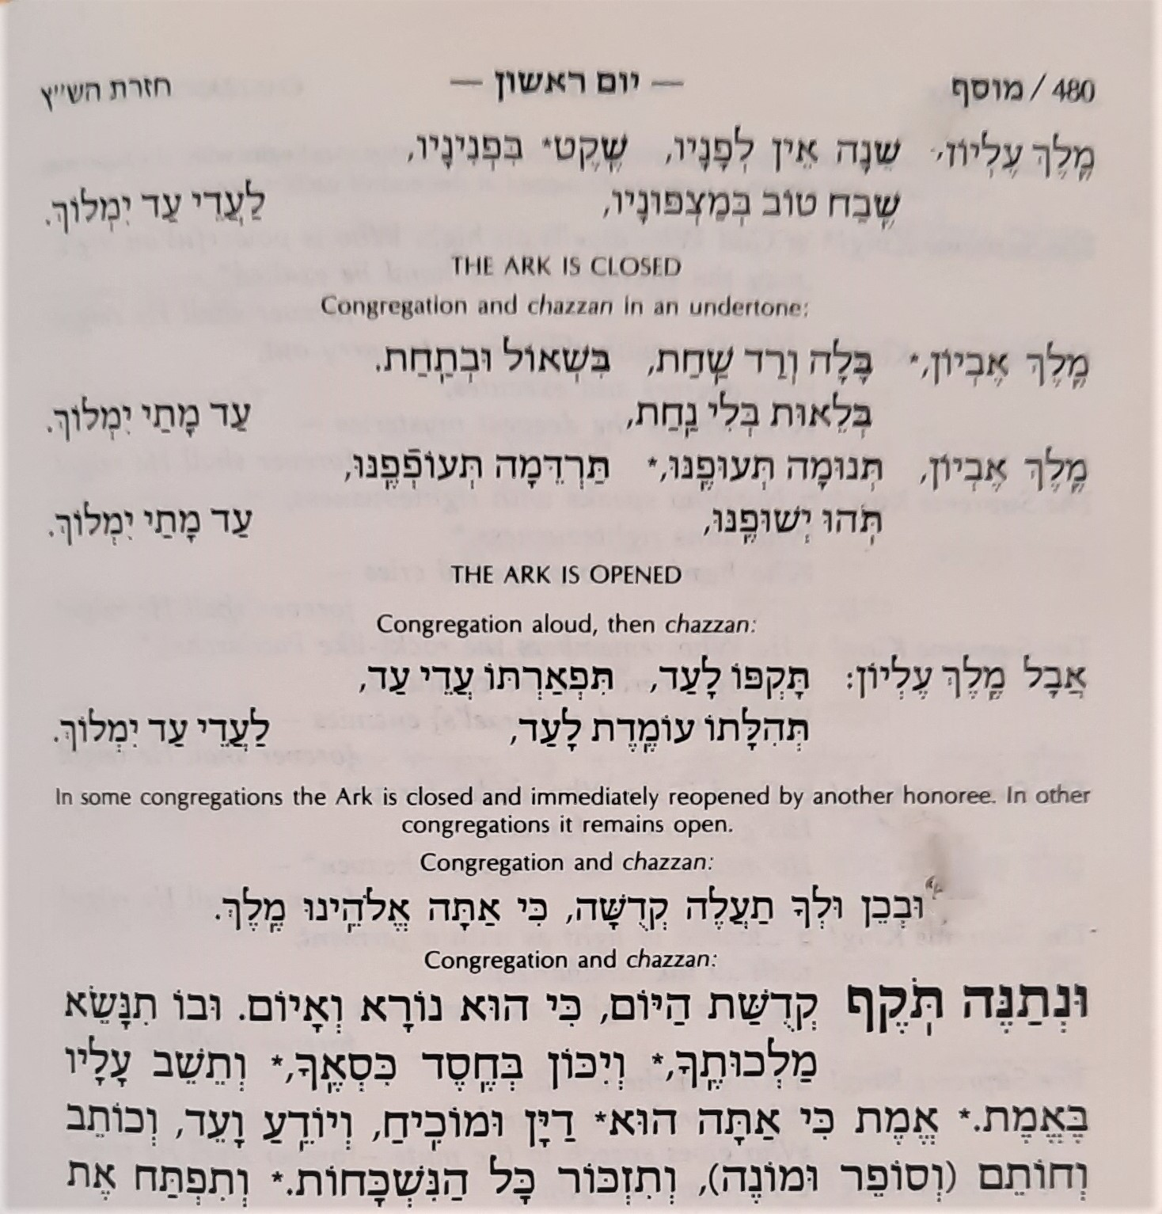
Start

Slide 14
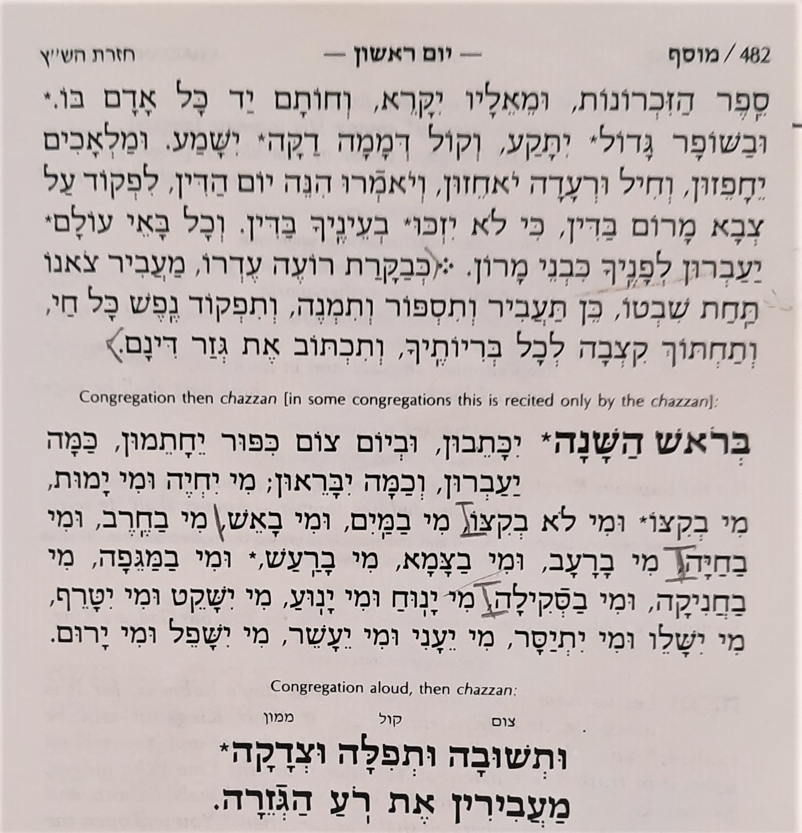
End

Slide 15
Ashamnu & Al Cheit page 132 in the Yom Kippur Artscroll page 46-52 in the Yom Kippur Routledge

Slide 16
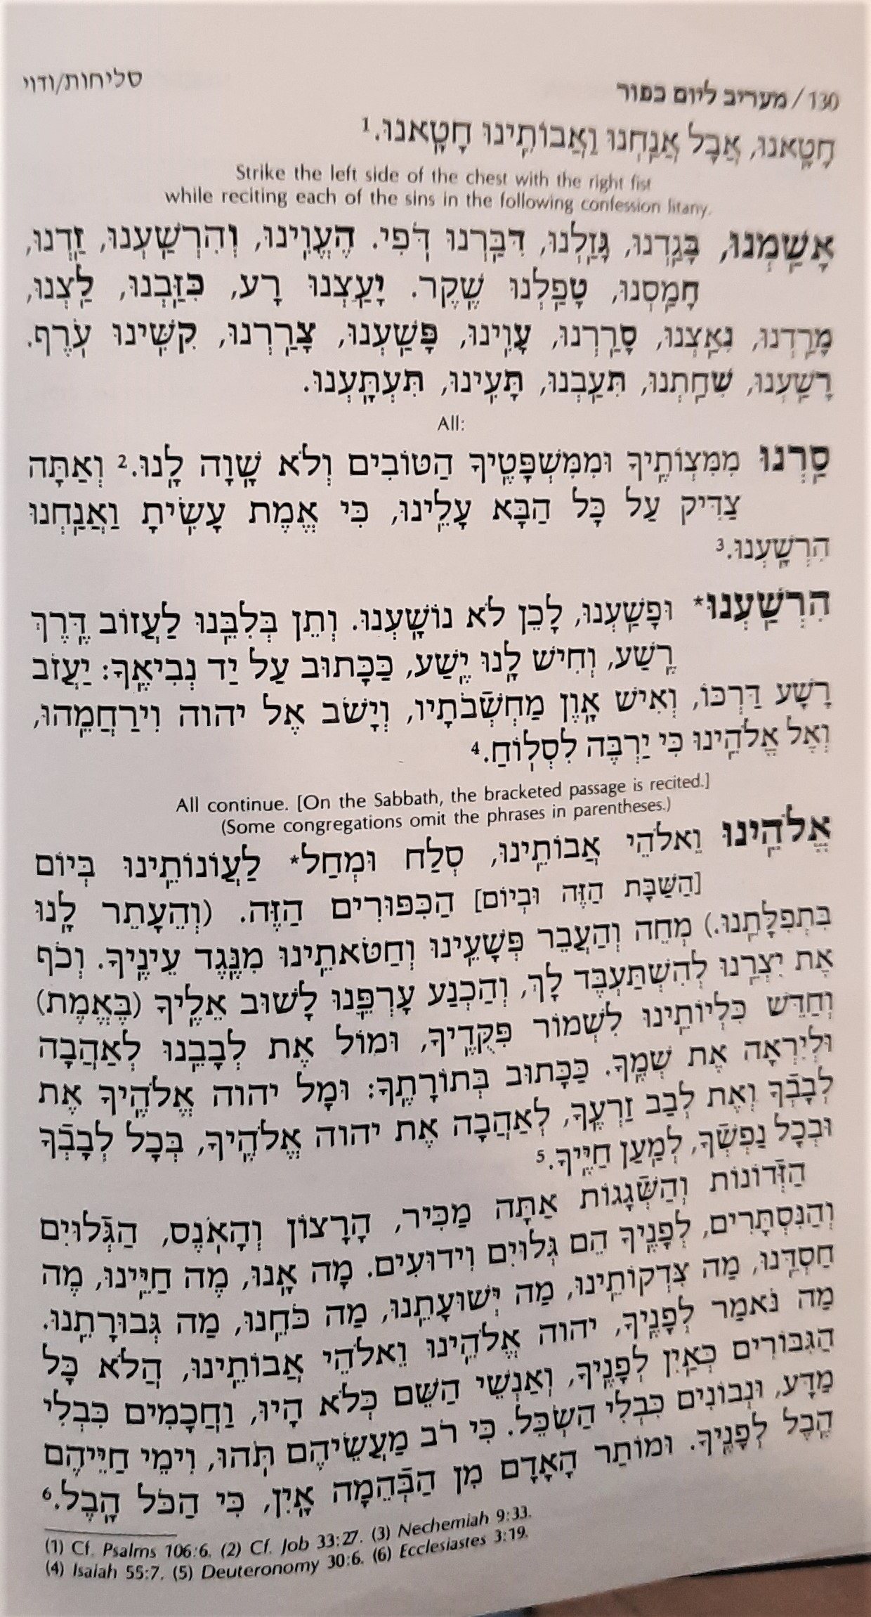
Start
End

Slide 17
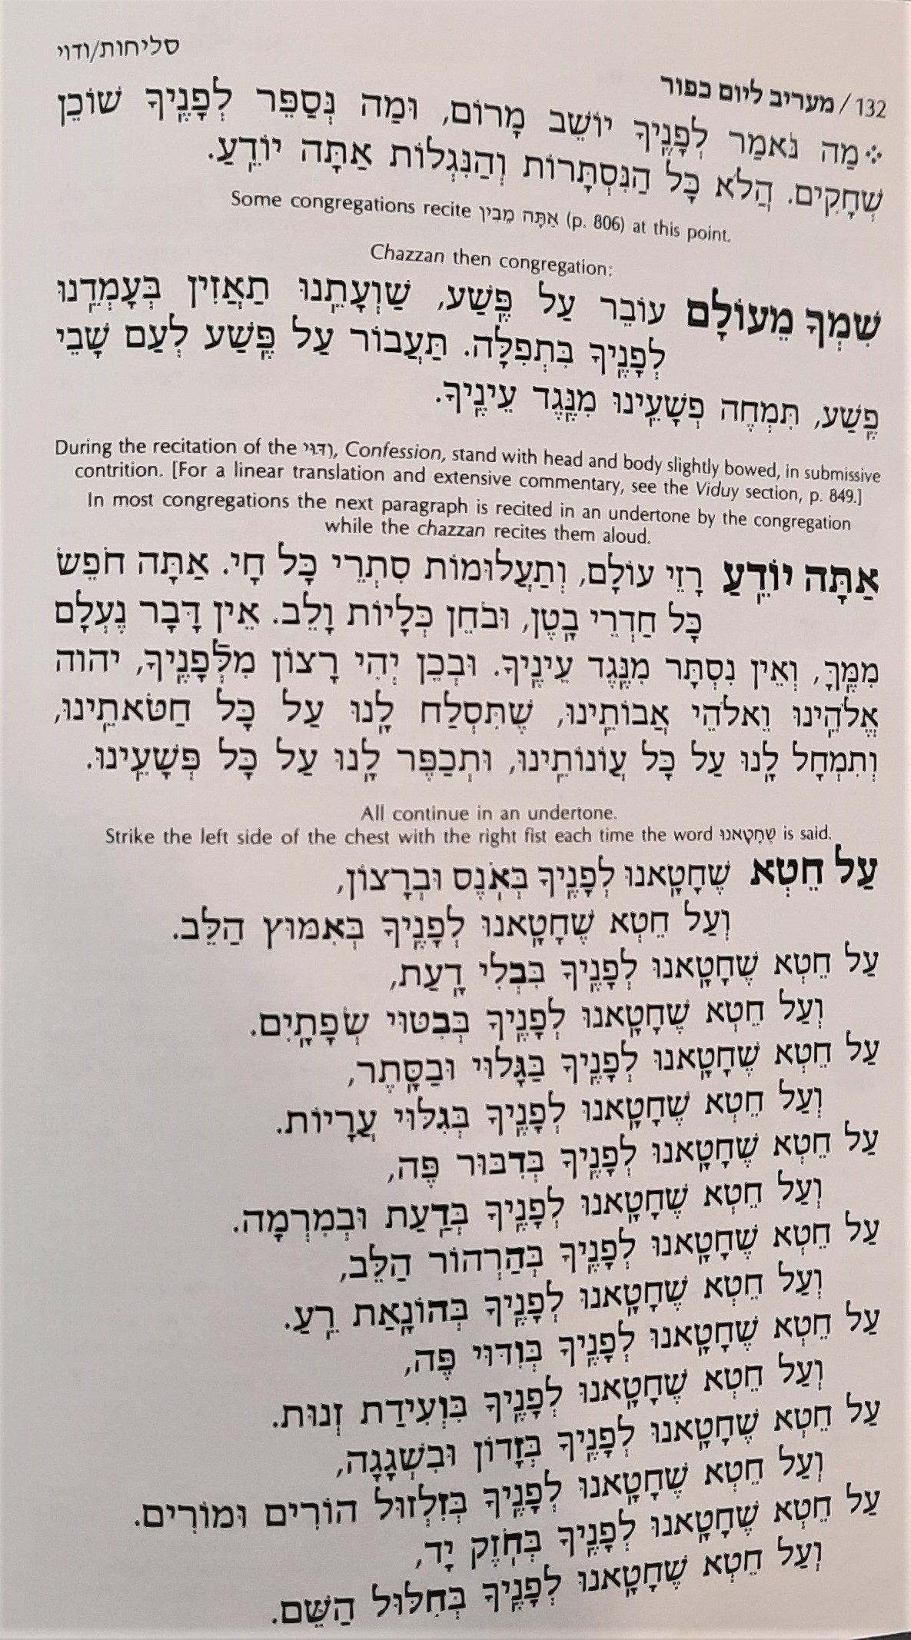
Start

Slide 18
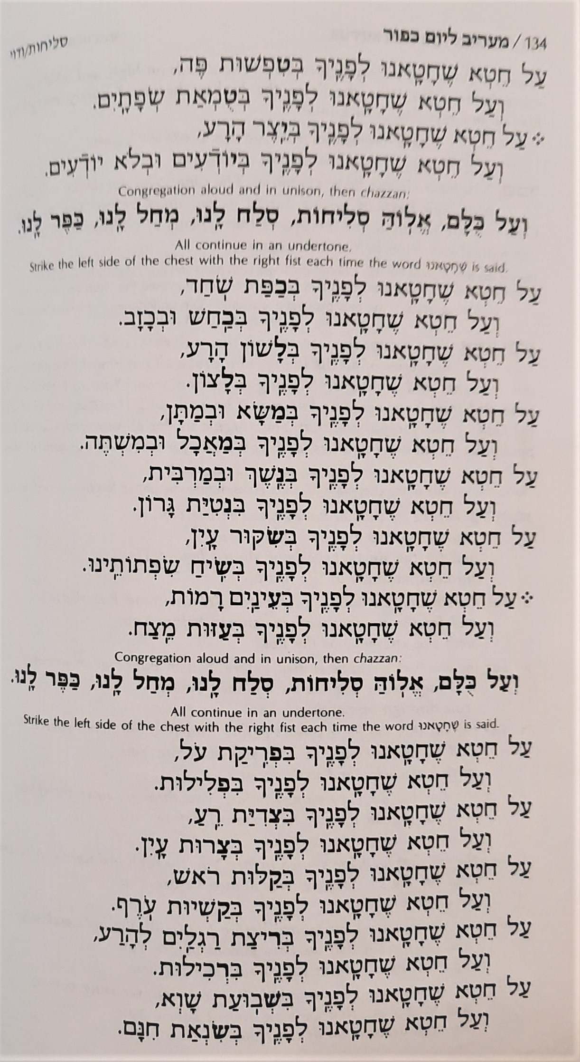

Slide 19
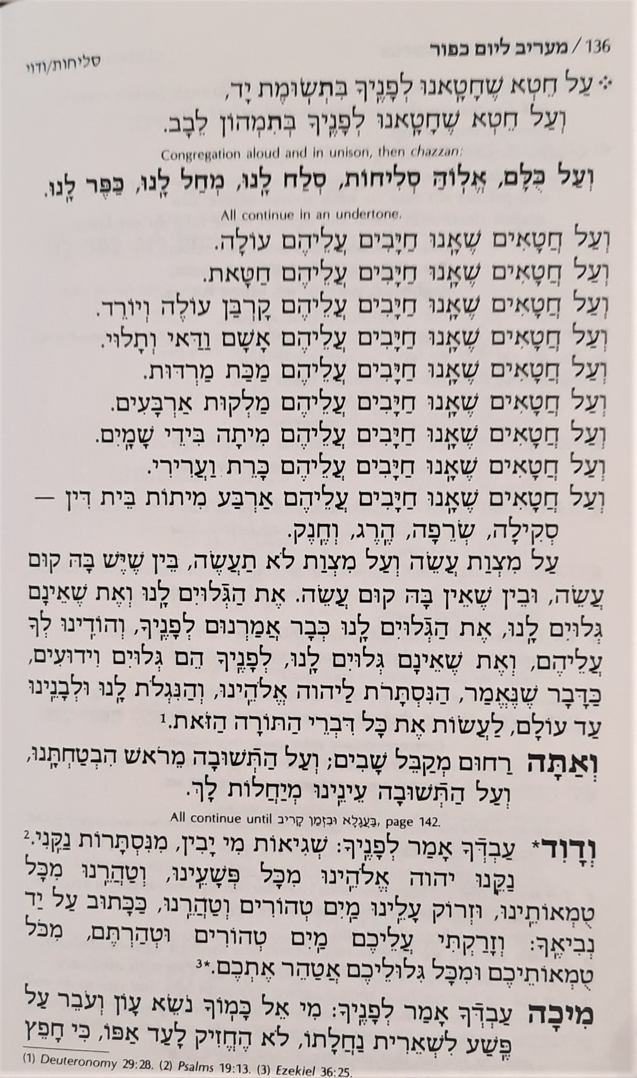
End

Slide 20
Hashem, Hashem page 110 in the Yom Kippur Artscroll page 40 in the Yom Kippur Routledge

Slide 21
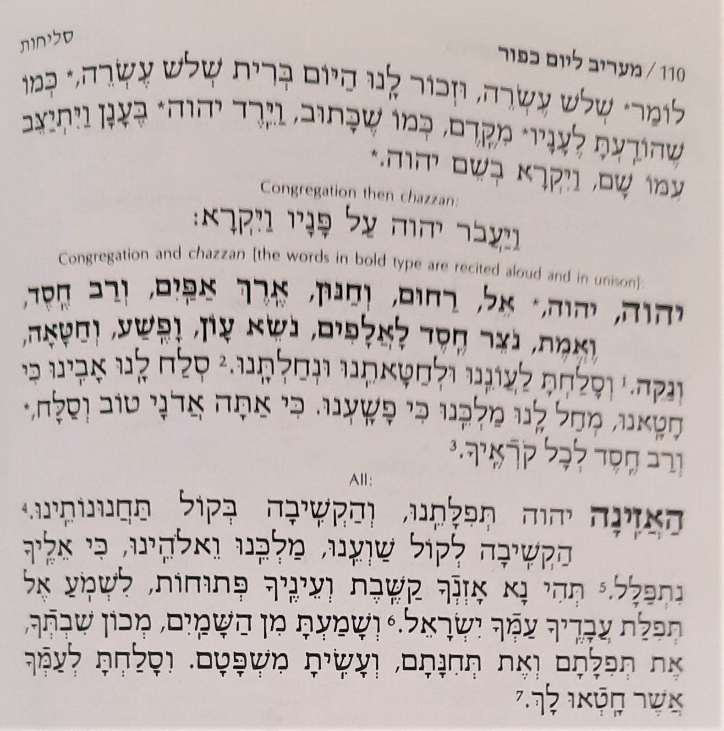
Start
End

